Slide 1

HTTP ANALYSIS FOR INCIDENT RESPONSE

Slide 2
INTRODUCTION
HTTP or Hyper Text Transfer Protocol, as the name suggests it is a protocol, it is a set of rules that the server needs to follow to transmit all kinds of files like images, text, audio, video, and other kinds over the world wide web (www)
Since HTTP is used for requesting and serving web pages, it is the most common type of traffic present on most networks and is not blocked at the network perimeter. As a result, it can be abused in a variety of different ways by a hacker.

Slide 3
AIM :
Monitoring HTTP traffic for malware network analysis.
We say HTTP specifically because HTTP is a popular protocol for malware authors since it is commonly allowed through firewalls and has numerous places to store command-and-control data.
TOOL USED :
WIRESHARK, is a packet sniffer and analysis tool. It captures network traffic on the local network and stores that data for offline analysis. The current stable release of Wireshark is 3.2.7.
VirusTotal is a website that aggregates many antivirus products and online scan engines to check for viruses that the user's own antivirus may have missed, or to verify against any false positives.

Slide 4
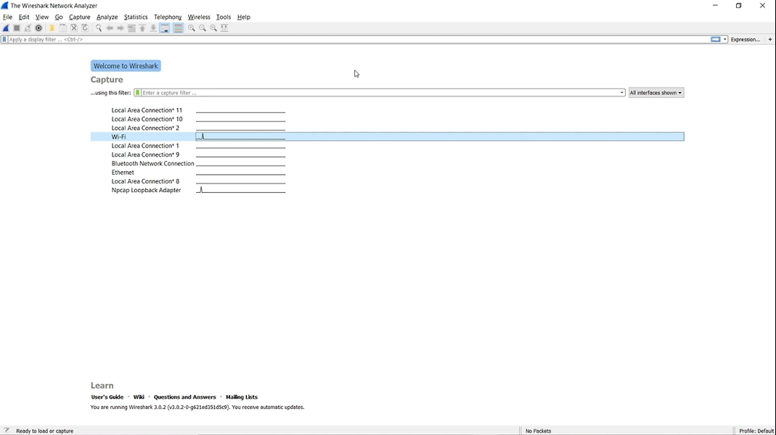
WIRESHARK INTERFACE
Selection of the interface required (WiFi in this case)

Slide 5
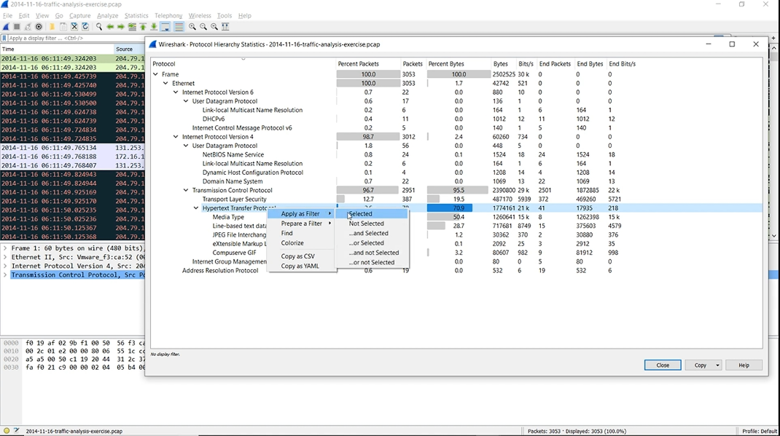
Different protocols captured and filtering out http among them

Slide 6
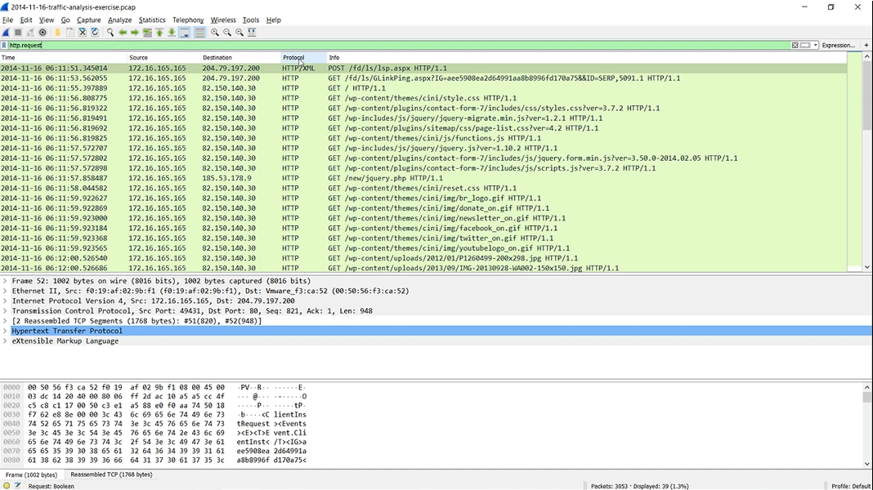
Filtering http requests

Slide 7
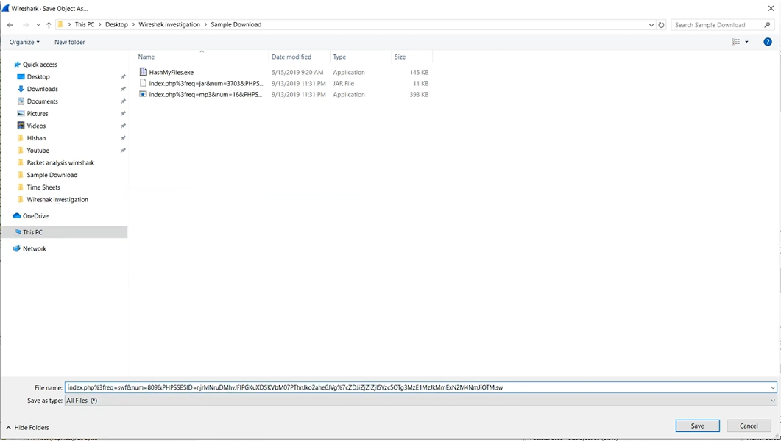
Identifying malicious files and saving them for checking

Slide 8
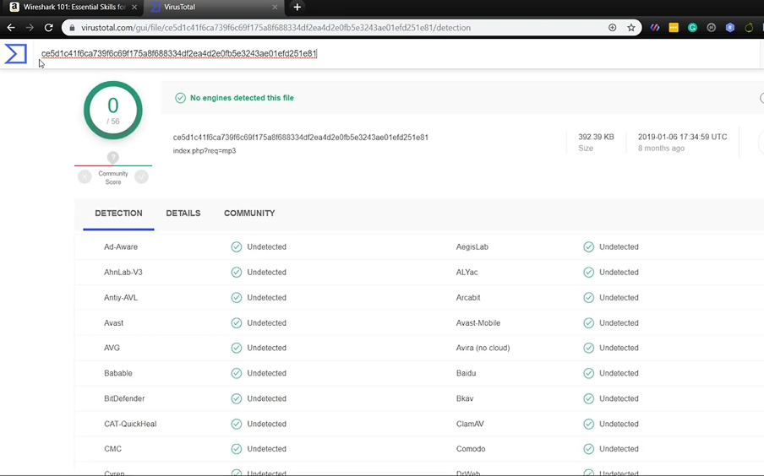
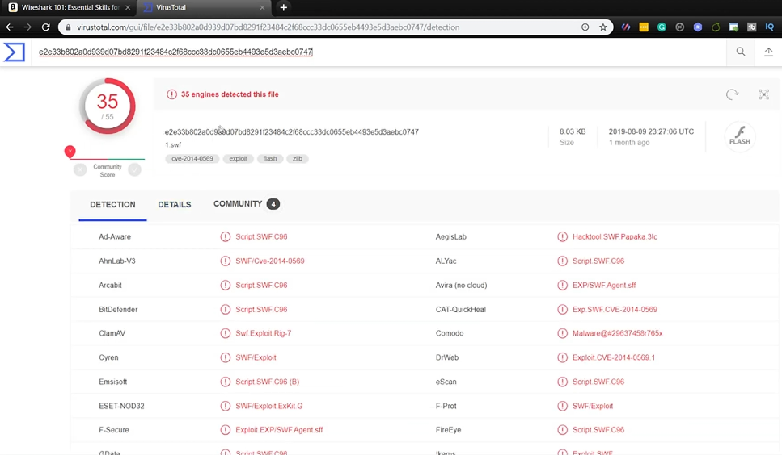
With virustotal.com the targetted files are checked .
This file is not malicious.
Example of an infected file.

Slide 9
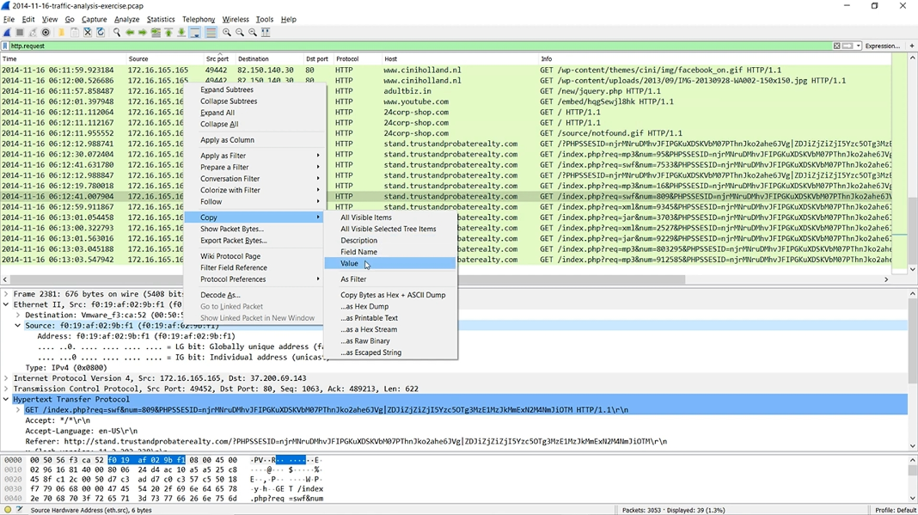
Finding the MAC address and required IP addresses

Slide 10
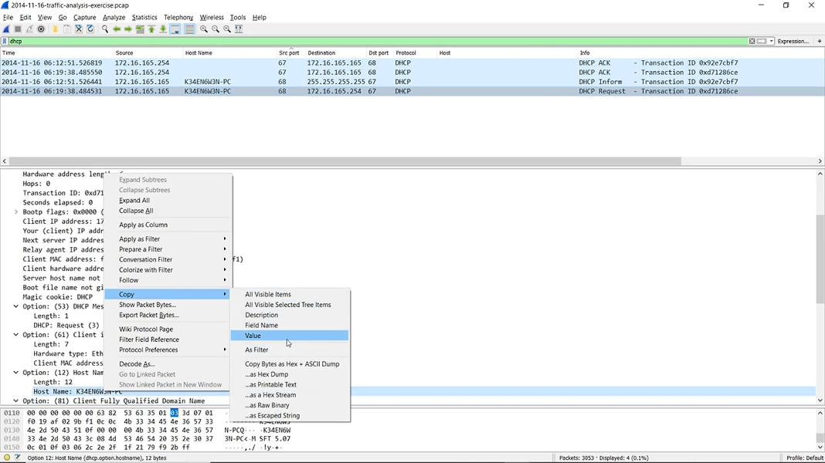
Finding the host name of the machine

Slide 11
The steps include obtaining
- URL source of the infected file.
- IP address of the website.
- Host name, MAC address of the infected machine.
- IP address of the infected machine.

Slide 12
APPLICATIONS AND ADVANTAGES
Investigation of malicious or infected files or websites can protect the network from further attacks.
This report that is obtained using wireshark enables us to block the IP address of the websites and troubleshoot the infected machine.
Wireshark lets you put your network traffic under a microscope, and provides tools to filter and drill down into that traffic, zooming in on the root cause of the problem.

Slide 13
THANK YOU
NAME : AVINASH.R
REG. NO. : 122004028

